Slide 1
Farmen Bauen
Mit L30
Und MatzE

Slide 2
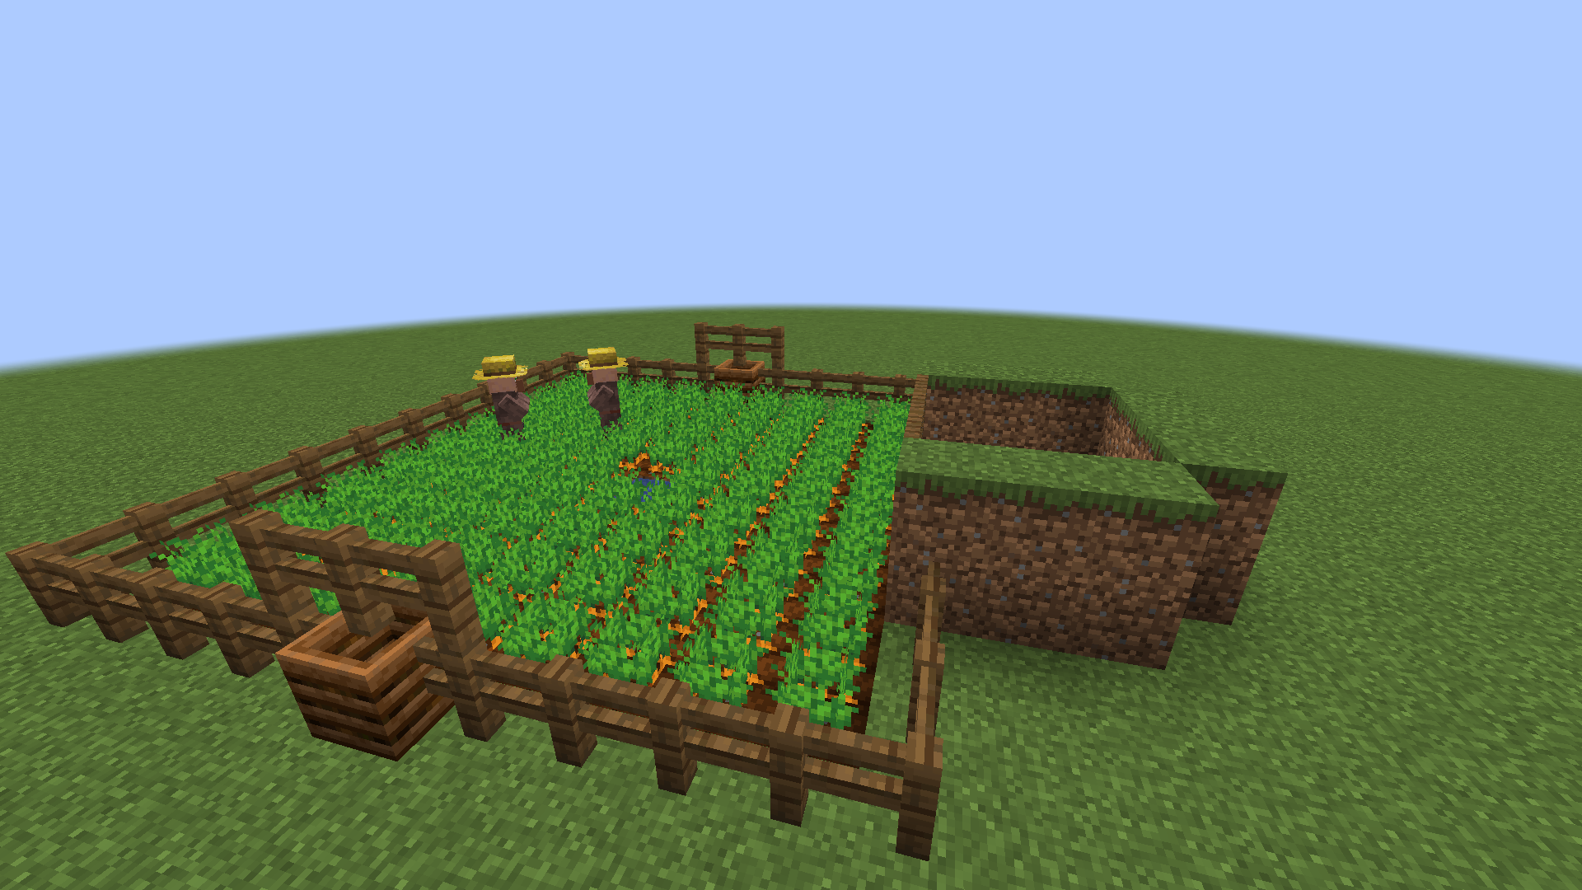

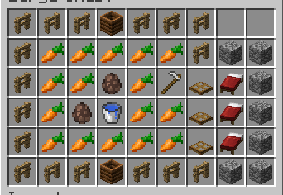
Villager breeder
Was du Brauchst:
-Zäune
-Komposter
-Karotten/Katoffeln
-eine Harke
-Baublöcke
-Betten
-Einen Wassereimer
-Dorfbewohner
-Falltühren
Werden wir hier etwa ausgenutzt?

Slide 3
Welches Item kommt in den meisten Rezepten vor?
?

Slide 4
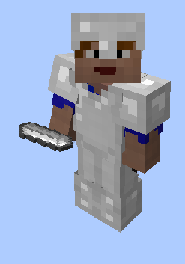
Welches Item kommt in den meisten Rezepten vor?
Rüstung
Technik
Werkzeuge
Transport

Slide 5
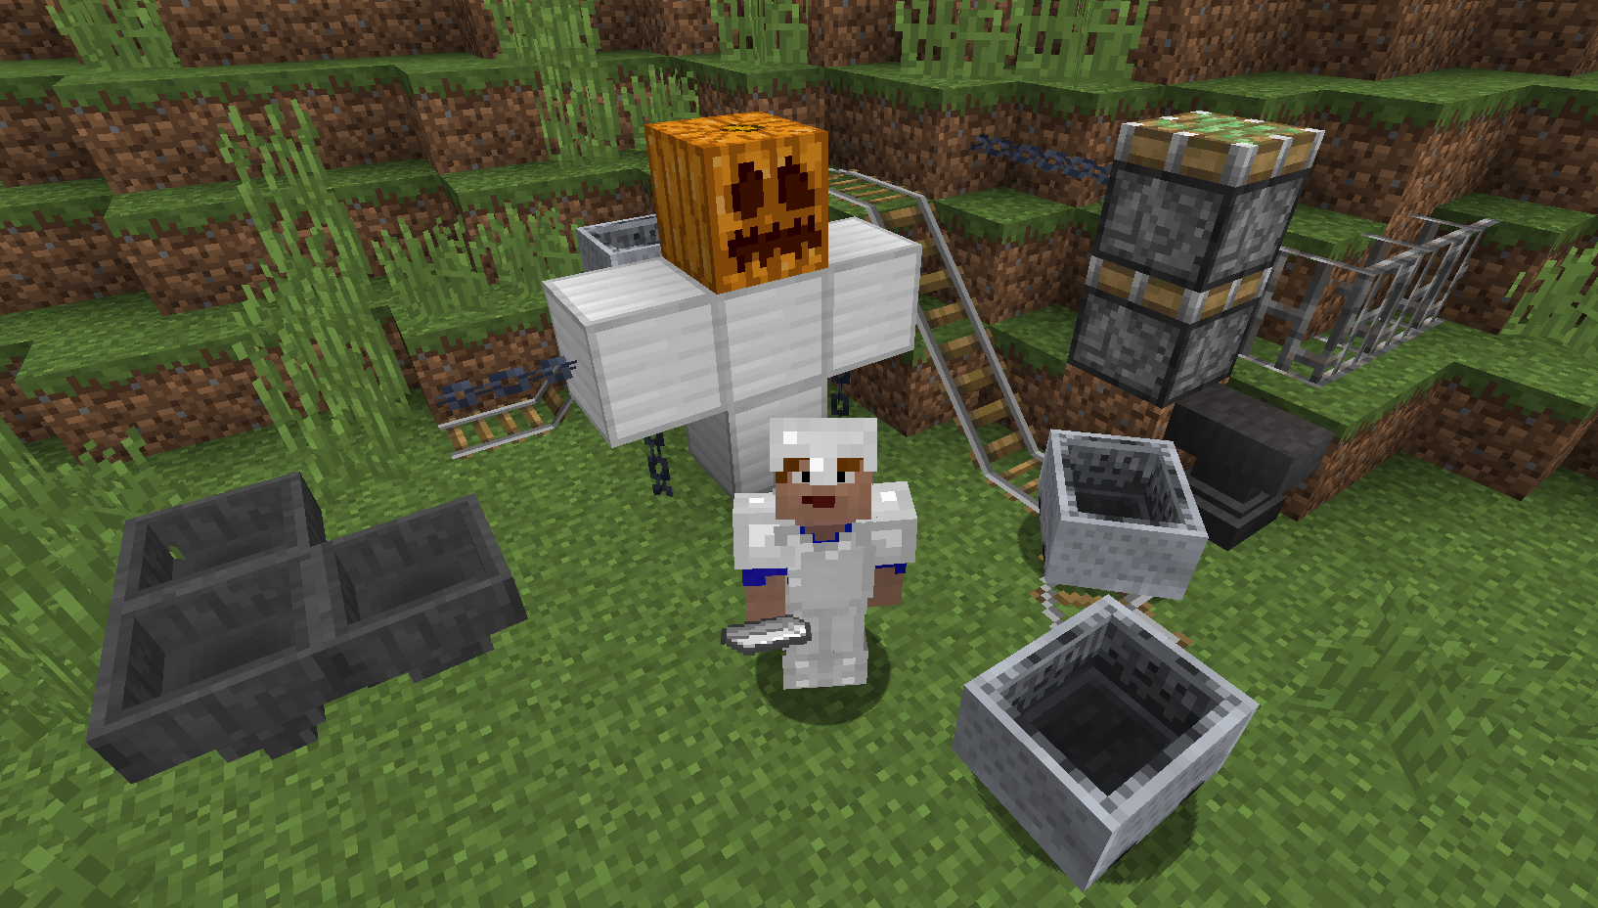
Welches Item kommt in den meisten Rezepten vor?
Rüstung
Technik
Werkzeuge
Transport

Slide 6
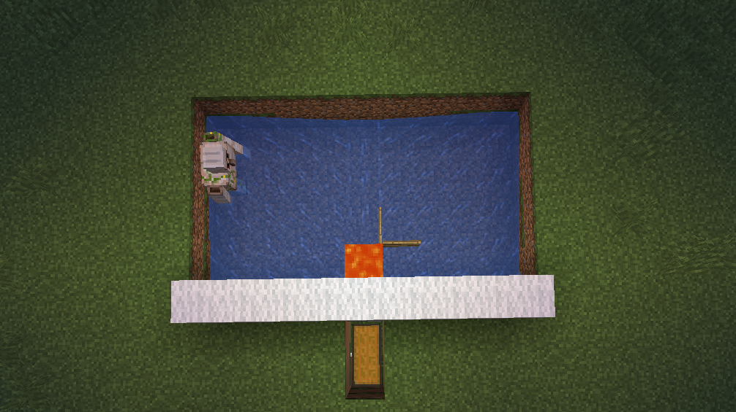
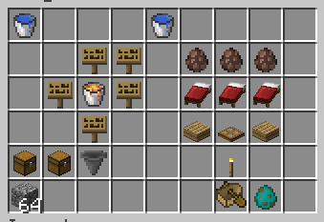
Eisen Farm
Werden wir hier etwa schon wieder ausgenutzt?

Slide 7
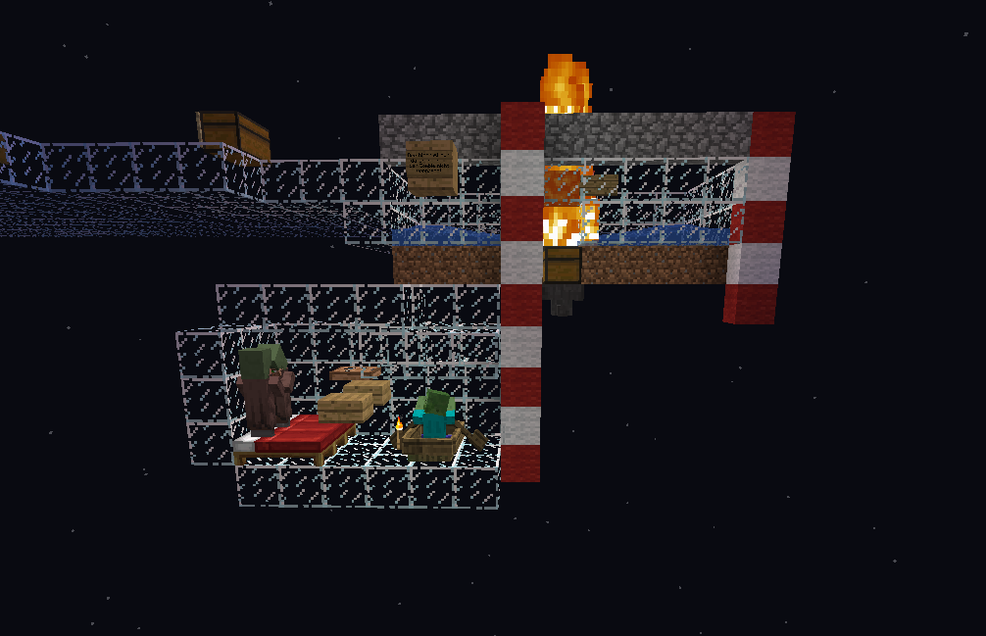

Slide 8
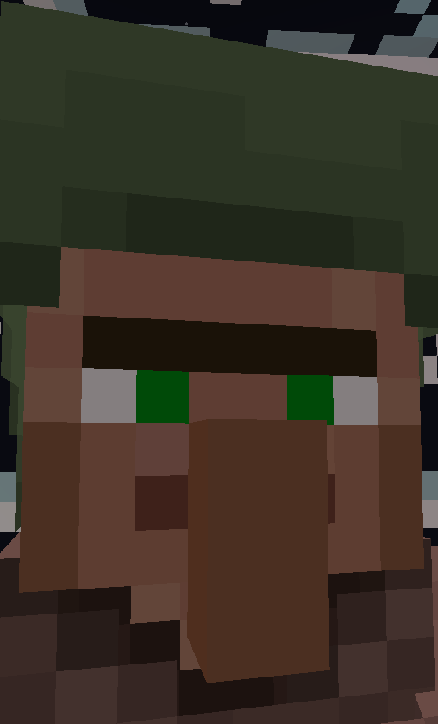
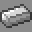
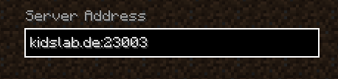
Jetzt seid ihr dran!
Eisenfarm
Vilager Breeder

Slide 9
“Danke fürs Mitmachen ;D”
–L30 & MatzE_

Slide 10
Quellen
https://www.youtube.com/watch?v=-oYyJ6jfSPU

Slide 11
YOU COULD USE THREE COLUMNS
MARS
MERCURY
SATURN
Despite being red, Mars is actually a cold place. It’s full of iron oxide dust
It’s the closest planet to the Sun and the smallest one in the Solar System
Yes, this is the ringed one. It’s composed mostly of hydrogen and helium

Slide 12
02.
PRESENTATION
You can enter a subtitle here if you need it

Slide 13

A PICTURE IS WORTH A THOUSAND WORDS

Slide 14
03.
ANALYSIS
You can enter a subtitle here if you need it

Slide 15
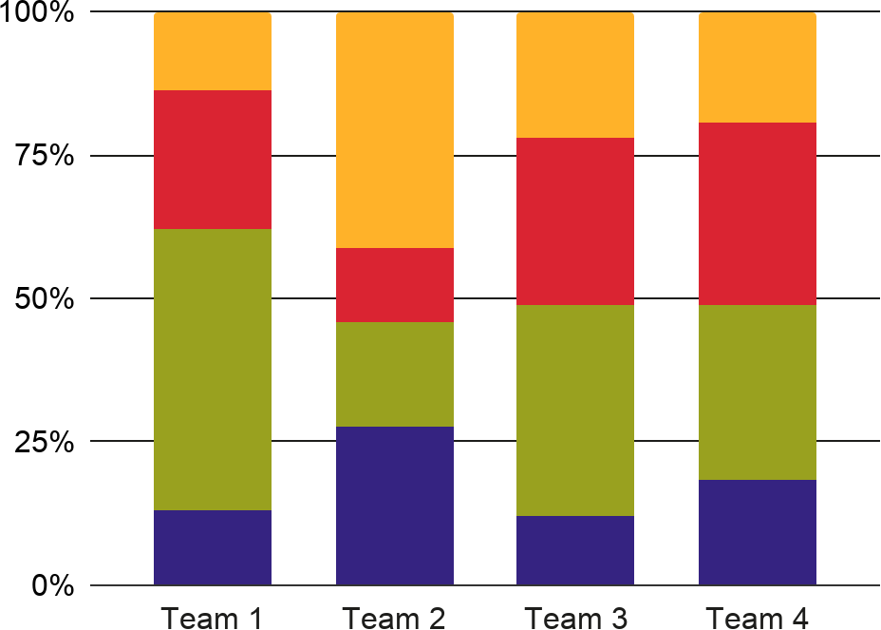
THIS IS A GRAPH
NEPTUNE
MERCURY
Neptune is the farthest planet
Mercury is the smallest planet
JUPITER
VENUS
Jupiter is the biggest planet
Venus has a beautiful name
To modify this graph, click on it, follow the link, change the data and paste the new graph here

Slide 16
AWESOME WORDS

Slide 17
REVIEWING CONCEPTS
MERCURY
VENUS
MARS
Mercury is the closest planet to the Sun
Venus has a beautiful name, but it’s terribly hot
Despite being red, Mars is a very cold place
JUPITER
SATURN
NEPTUNE
It’s the biggest planet in the Solar System
Saturn is the ringed one and a gas giant
Neptune is the farthest planet from the Sun

Slide 18
A TABLE
 | MERCURY | VENUS | SATURN
SATURN | 0.06 | 0.38 | 0.38
NEPTUNE | 0.11 | 0.53 | 0.38
MARS | 95.2 | 9.4 | 1.16

Slide 19
THIS IS A MAP
MERCURY
Mercury is the smallest planet
VENUS
Venus has a beautiful name

Slide 20
A TIMELINE
Venus has a beautiful name
Neptune is the farthest planet
1
3
VENUS
NEPTUNE
MERCURY
JUPITER
Mercury is the smallest planet
2
Jupiter is the biggest planet
4

Slide 21
4,498,300,000
Big numbers catch your audience’s attention

Slide 22
34.45K
67.89M
Mercury is the closest planet to the Sun
Venus has a beautiful name, but it’s terribly hot

Slide 23
04.
CONCLUSION
You can enter a subtitle here if you need it

Slide 24
CONCLUSION
Mercury is the closest planet to the Sun and the smallest one in the Solar System—it’s only a bit larger than the Moon. The planet’s name has nothing to do with the liquid metal

Slide 25
YOU COULD USE FOUR COLUMNS
SATURN
JUPITER
Saturn is the ringed one and a gas giant
It’s the biggest planet in the Solar System
VENUS
MARS
Venus has a beautiful name, but it’s terribly hot
Despite being red, Mars is a very cold place

Slide 26
OUR SERVICES
FREE
PRO
PREMIUM
You can explain your
product or your service
Characteristic
Characteristic
You can explain your
product or your service
Characteristic
Characteristic
You can explain your
product or your service
Characteristic
Characteristic
$0
$60
$85

Slide 27

OUR TEAM
Mercury is the closest planet to the Sun and the smallest one in the Solar System—it’s only a bit larger than the Moon. The planet’s name has nothing to do with the liquid metal

Slide 28

DESKTOP SOFTWARE
You can replace the image on the screen with your own work. Just delete this one, add yours and center it properly

Slide 29
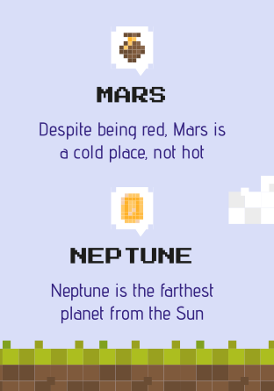
TABLET APP
You can replace the image on the screen with your own work. Just delete this one, add yours and center it properly

